Slide 1

Monocular Camera Localization in 3D LiDAR Maps
Speaker: Yunxiang Lu and Keyue Zhang
Supervisor: Simon Klenk
Vision-based Navigation
Garching b. München, 24. July 2023

Slide 2
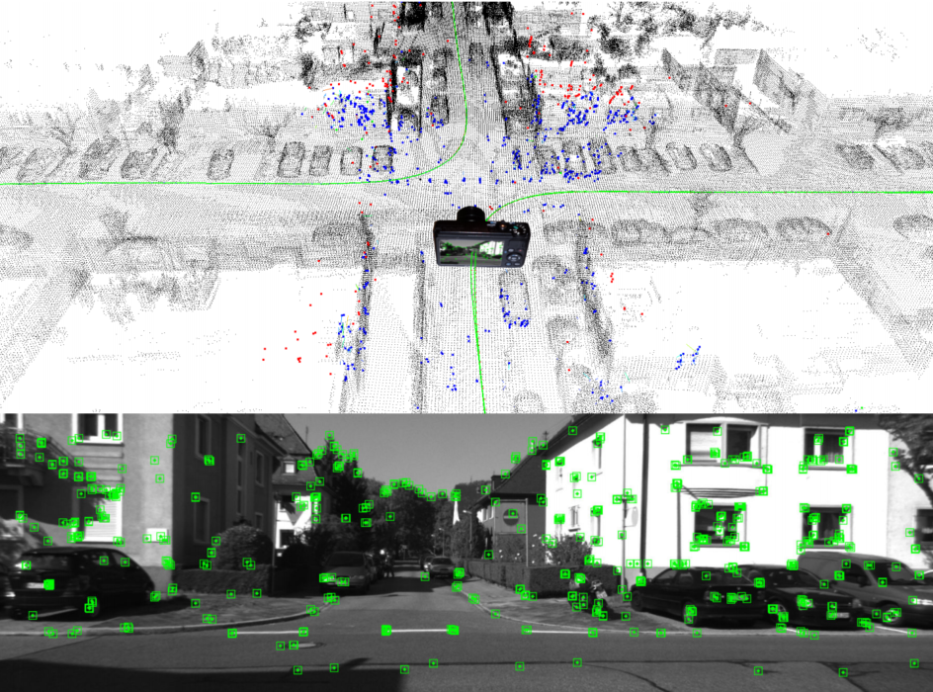
Introduction
Goal: Localize the monocular camera in a 3D LiDAR Map
Input: Image stream + 3D point cloud map
Output: Estimated camera pose trajectory
Method: Align the reconstructed point to 3D LiDAR Map
Alignment by matching geometry
Eliminate the accumulated drift
Figure 1: Caselitz, et al. “Monocular Camera Localization in 3D LiDAR Maps.”

Slide 3
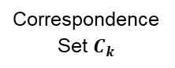
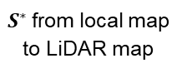
Visual Odometry
New Frame
Localize Camera
Data Association
No
Is Keyframe?
Correspondence Set $C_{k}$
Iterate K times
Yes
Add New Landmarks
Optimize Alignment
Local Bundle Adjustment
$S^{∗}$from local map to LiDAR map
Alignment with LiDAR Map
Update landmarks and camera poses

Slide 4
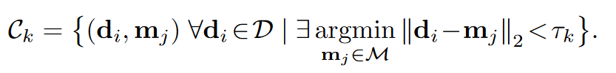
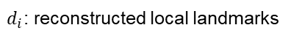
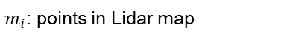
Alignment-Data Association
1
Find correspondences between reconstructed points and points in Lidar map iteratively
1
2
3
2
3
Local landmark
LiDAR point
Distance threshold
$d_{i}$: reconstructed local landmarks
$m_{i}$: points in Lidar map
Notes:
How can we get the data association?
1Iteratively, for each reconstructed point, we find its nearest neighbor in the map, If the nearest neighbor is close enough, the pair is added to the correspondence set.
2Compute similarity transformation estimate according to current correspondence.
As the algorithm converges, point-to-point distances are decreasing in every iteration, thus we can choose the threshold more strictly in order to retain only high-quality associations.
However this method has a significant drawback, that the set of reconstructed points overlaps only partially with the lidar map.
Therefore points di might have no meaningful correspondence in Lidarmap which will lead to bad performance.

Slide 5
Alignment-Data Association
1
Find correspondences between reconstructed points and points in Lidar map iteratively
1
2
3
2
3
Not scanned by LiDAR !!!
Local landmark
LiDAR point
Distance threshold
Drawback：
the set of reconstructed points overlaps only partially with the LiDAR map
$d_{i}$: reconstructed local landmarks
$m_{i}$: points in Lidar map
Notes:
How can we get the data association?
1Iteratively, for each reconstructed point, we find its nearest neighbor in the map, If the nearest neighbor is close enough, the pair is added to the correspondence set.
2Compute similarity transformation estimate according to current correspondence.
As the algorithm converges, point-to-point distances are decreasing in every iteration, thus we can choose the threshold more strictly in order to retain only high-quality associations.
However this method has a significant drawback, that the set of reconstructed points overlaps only partially with the lidar map.
Therefore points di might have no meaningful correspondence in Lidarmap which will lead to bad performance.

Slide 6
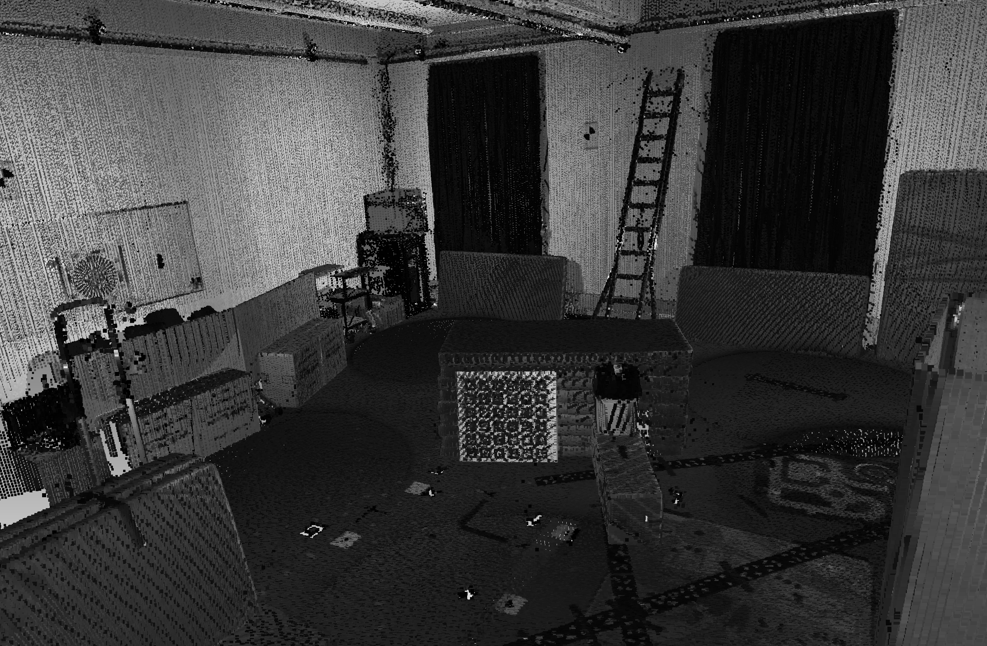
Alignment-Local Point Distribution
Preprocessing
Voxelize the point cloud map
Use PCA to determine the local point distribution in each voxel
Voxelize
3D Point Cloud Map
Voxelized Map
One Voxel in the Map
Notes:
The problem mentioned above have severe consequences in terms of accuracy, we have to refine the correspondence set using the map’s local point distribution.
The objective is to filter out correspondences associating points di that are located in areas not covered by or on the boundaries of the map.
~the local point is constructed offline, its computation does not affect the online performance of our method.

Slide 7
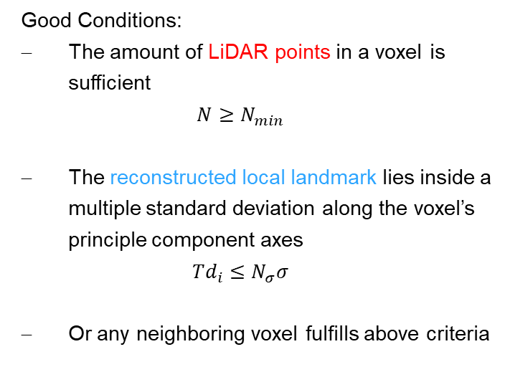
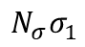
Alignment-Filter out bad correspondence
Good Conditions:
The amount of LiDAR points in a voxel is sufficient
$$N≥N_{min}$$
The reconstructed local landmark lies inside a multiple standard deviation along the voxel’s principle component axes
$$Td_{i}≤N_{σ}σ$$
Or any neighboring voxel fulfills above criteria
fulfilled
Not fulfilled
filtered out
$${N_{σ}σ}_{1}$$
reconstructed local landmarks
points in Lidar map
Notes:
The problem mentioned above have severe consequences in terms of accuracy, we have to refine the correspondence set using the map’s local point distribution.
The objective is to filter out correspondences associating points di that are located in areas not covered by or on the boundaries of the map.
~the local point is constructed offline, its computation does not affect the online performance of our method.

Slide 8
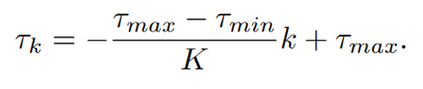
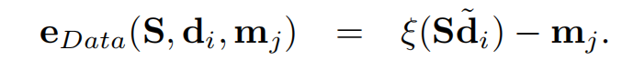
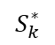
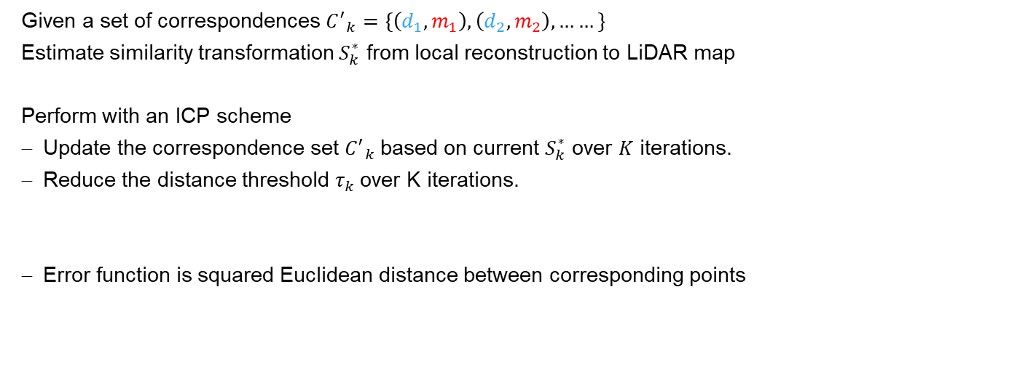
Alignment-Optimization
Given a set of correspondences ${C^{′}}_{k}=\left\{\left(d_{1},m_{1}\right),\left(d_{2},m_{2}\right),……\right\}$
Estimate similarity transformation $S_{k}^{∗}$ from local reconstruction to LiDAR map
Perform with an ICP scheme
Update the correspondence set ${C^{′}}_{k}$based on current $S_{k}^{∗}$ over $K$ iterations.
Reduce the distance threshold $τ_{k}$over K iterations.
Error function is squared Euclidean distance between corresponding points
1
1
2
3
2
3
$$S_{k}^{∗}$$

Slide 9

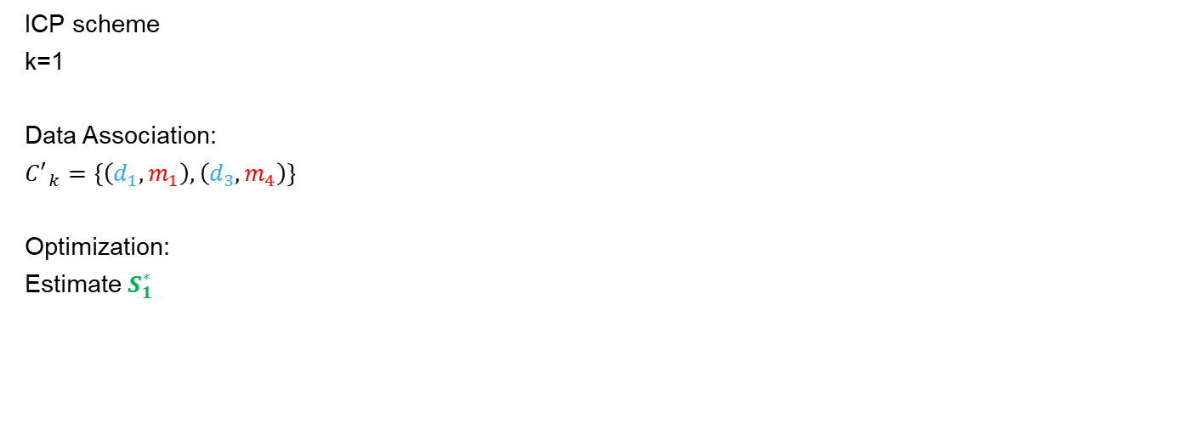
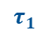
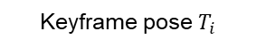
Alignment-Optimization
reconstructed local landmarks
points in Lidar map
ICP scheme
k=1
Data Association:
$${C^{′}}_{k}=\left\{\left(d_{1},m_{1}\right),\left(d_{3},m_{4}\right)\right\}$$
Optimization:
Estimate $S_{1}^{∗}$
1
1
2
3
2
4
3
4
$$S_{1}^{∗}$$
$$τ_{1}$$
Keyframe pose $T_{i}$

Slide 10
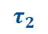
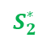
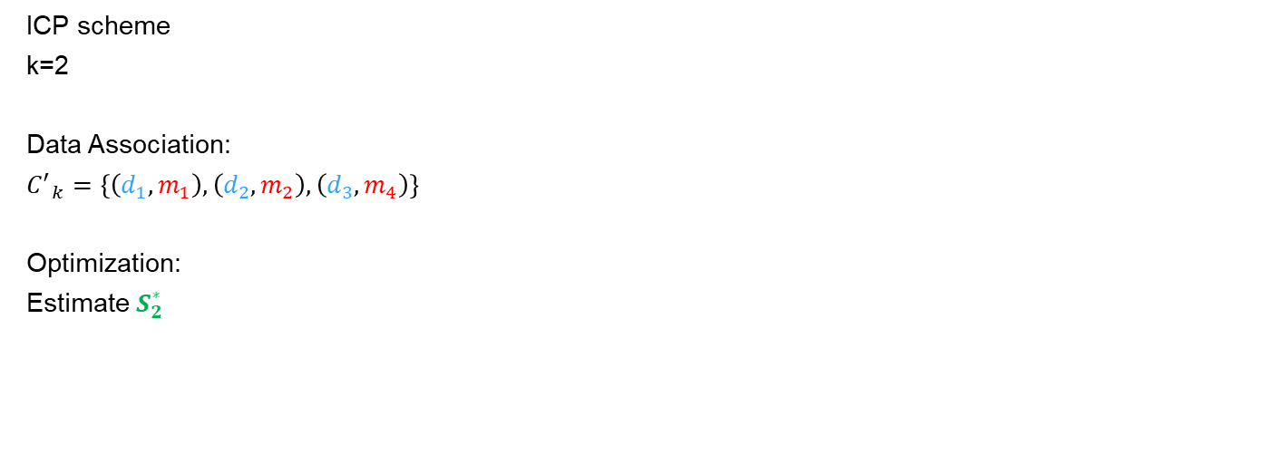
Alignment-Optimization
reconstructed local landmarks
points in Lidar map
ICP scheme
k=2
Data Association:
$${C^{′}}_{k}=\left\{\left(d_{1},m_{1}\right),\left(d_{2},m_{2}\right),\left(d_{3},m_{4}\right)\right\}$$
Optimization:
Estimate $S_{2}^{∗}$
1
1
2
2
3
4
3
$$τ_{2}$$
4
$$S_{2}^{∗}$$

Slide 11
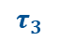
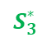
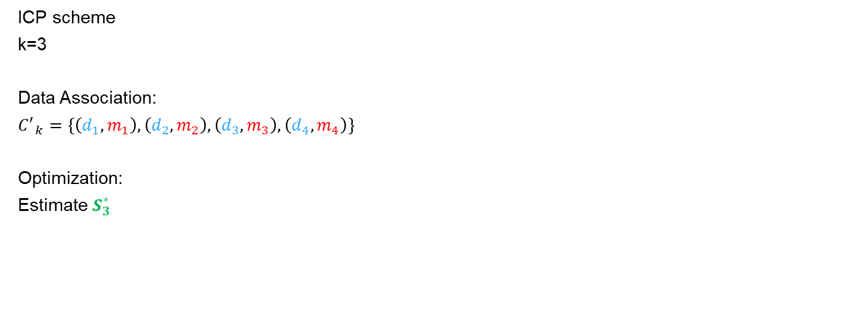
Alignment-Optimization
reconstructed local landmarks
points in Lidar map
ICP scheme
k=3
Data Association:
$${C^{′}}_{k}=\left\{\left(d_{1},m_{1}\right),\left(d_{2},m_{2}\right),\left(d_{3},m_{3}\right),\left(d_{4},m_{4}\right)\right\}$$
Optimization:
Estimate $S_{3}^{∗}$
1
1
2
2
3
3
4
$$τ_{3}$$
4
$$S_{3}^{∗}$$

Slide 12

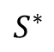
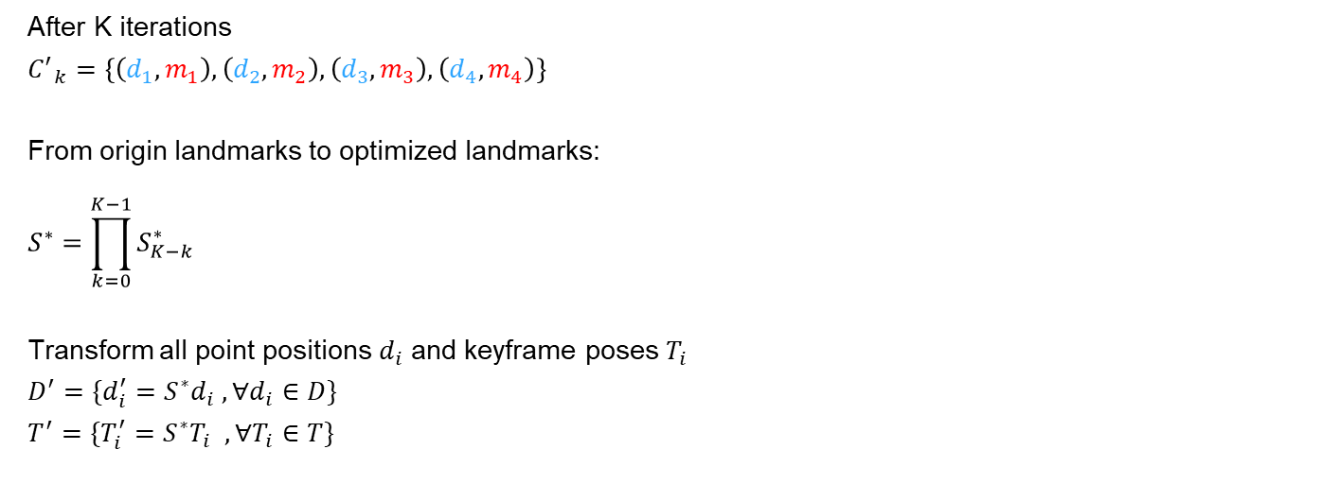
Alignment-Update landmarks and poses
reconstructed local landmarks
$$S^{∗}$$
points in Lidar map
After K iterations
$${C^{′}}_{k}=\left\{\left(d_{1},m_{1}\right),\left(d_{2},m_{2}\right),\left(d_{3},m_{3}\right),\left(d_{4},m_{4}\right)\right\}$$
From origin landmarks to optimized landmarks:
$$S^{∗}=\prod_{k=0}^{K−1}{S_{K−k}^{∗}}$$
Transform all point positions $d_{i}$ and keyframe poses $T_{i}$
$$D^{′}=\{d_{i}^{′}=S^{∗}d_{i} , ∀d_{i}∈D\}$$
$$T^{′}=\{T_{i}^{′}=S^{∗}T_{i} , ∀T_{i}∈T\}$$
1
1
1
2
2
3
2
4
3
4
3
4
$$T_{i}^{′}=S^{∗}T_{i}$$
Keyframe pose $T_{i}$

Slide 13
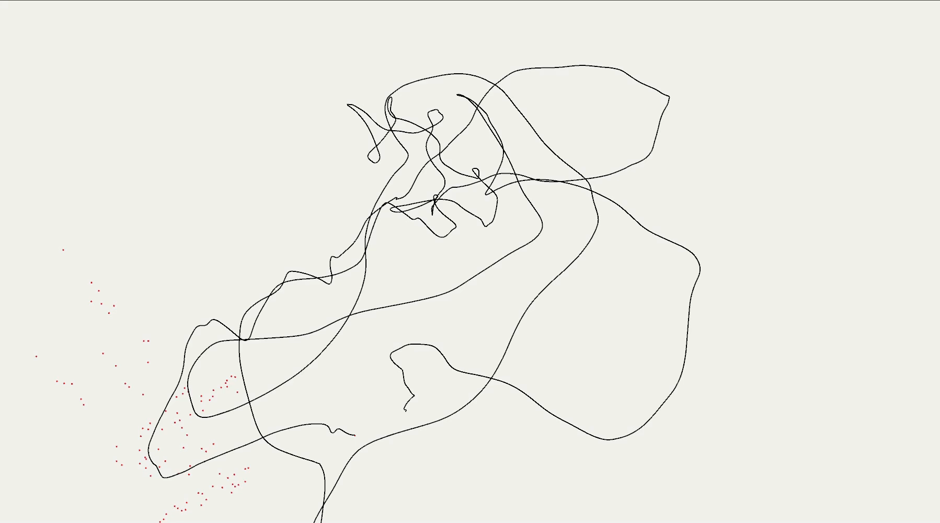
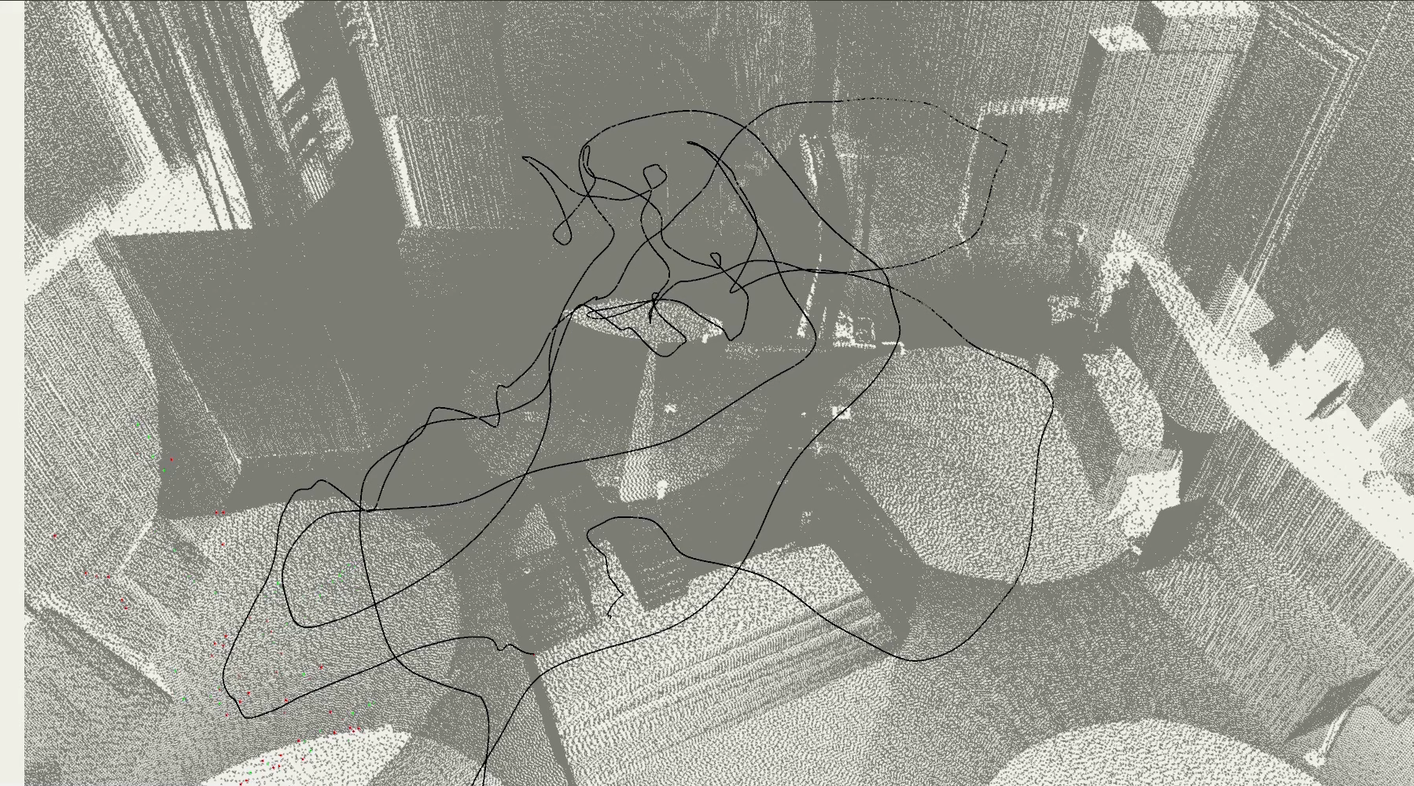
Result-Stereo Camera for Euroc V1_01_easy
Stereo without alignment
1 min 23 s (~30Hz)
Stereo with alignment
3 min 53 s (~12Hz)

Slide 14
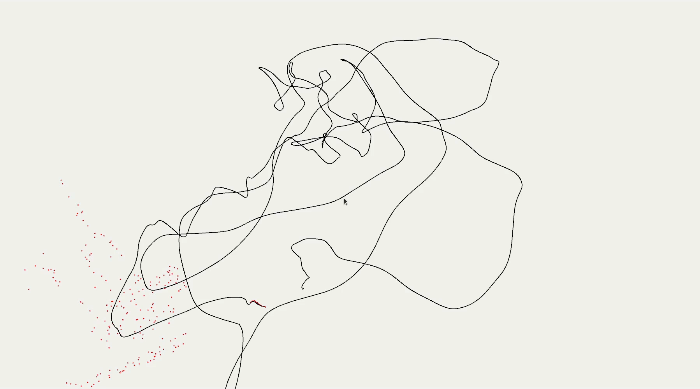
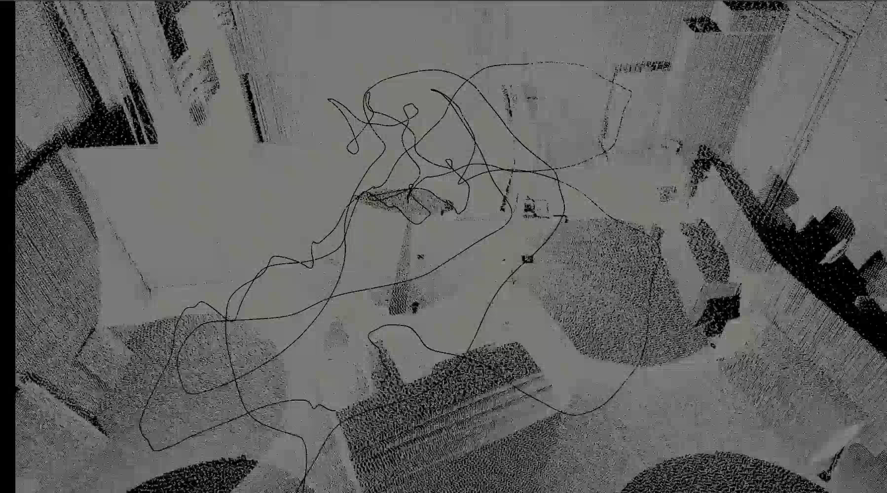
Result-Monocular Camera for Euroc V1_01_easy
Monocular without alignment
1 min 09 s (~40Hz)
Monocular with alignment
2 min 57 s (~15Hz)

Slide 15
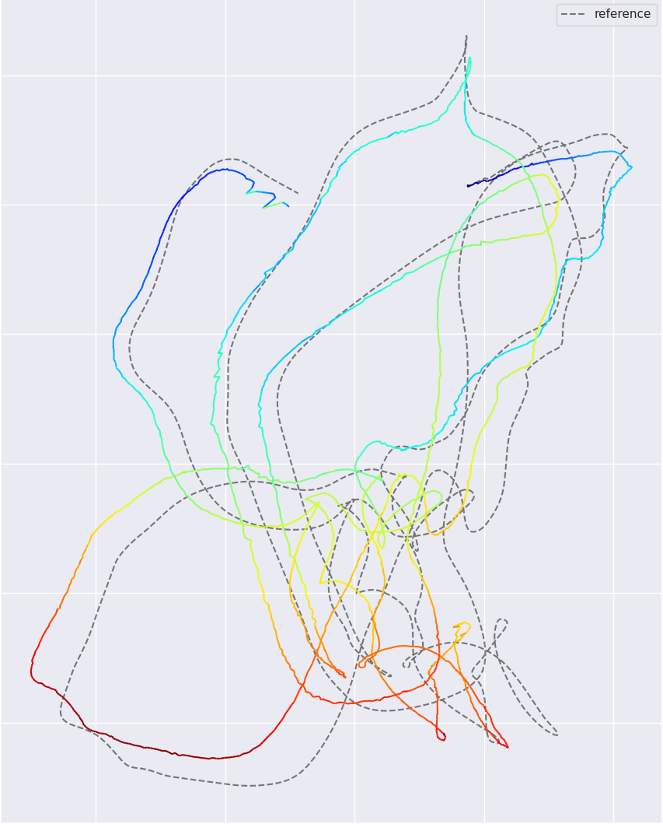
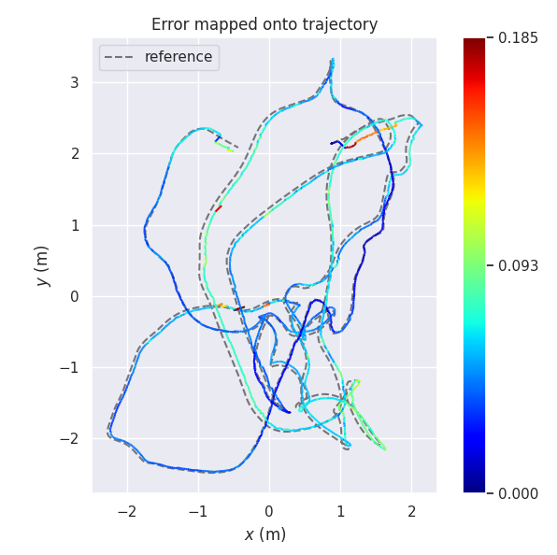
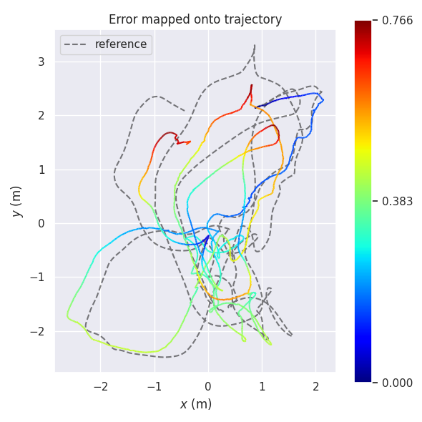
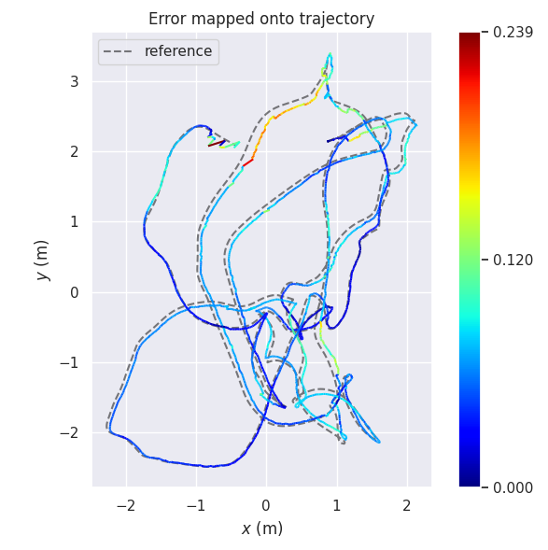
Result for V1_01_easy
Stereo
Stereo + LiDAR map
Monocular
Monocular + LiDAR map

Slide 16
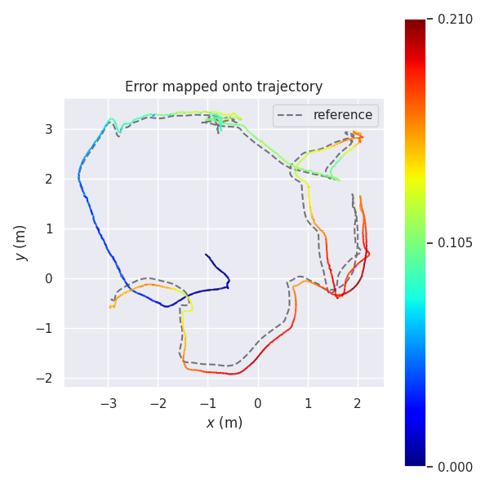
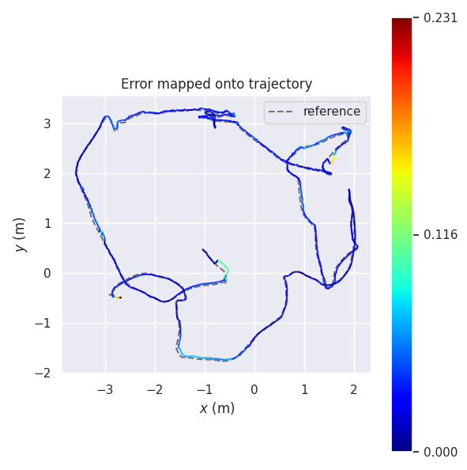
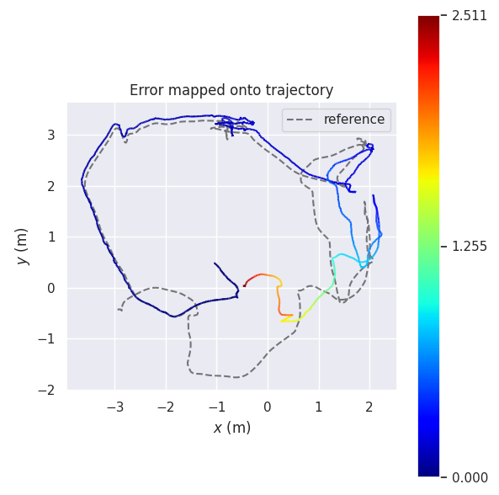
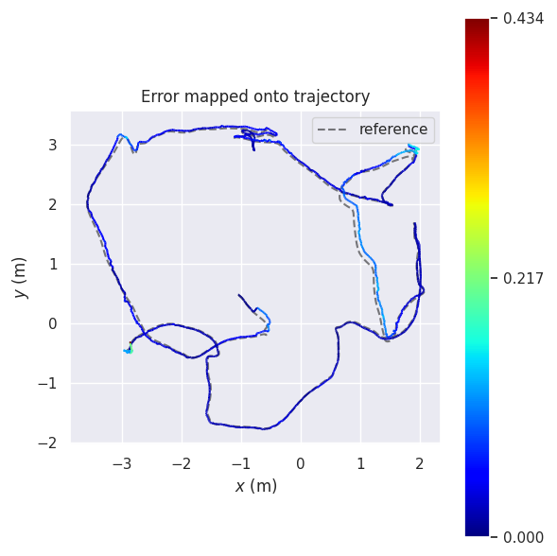
Result for V2_01_easy
Stereo
Stereo + LiDAR map
Monocular
Monocular + LiDAR map

Slide 17
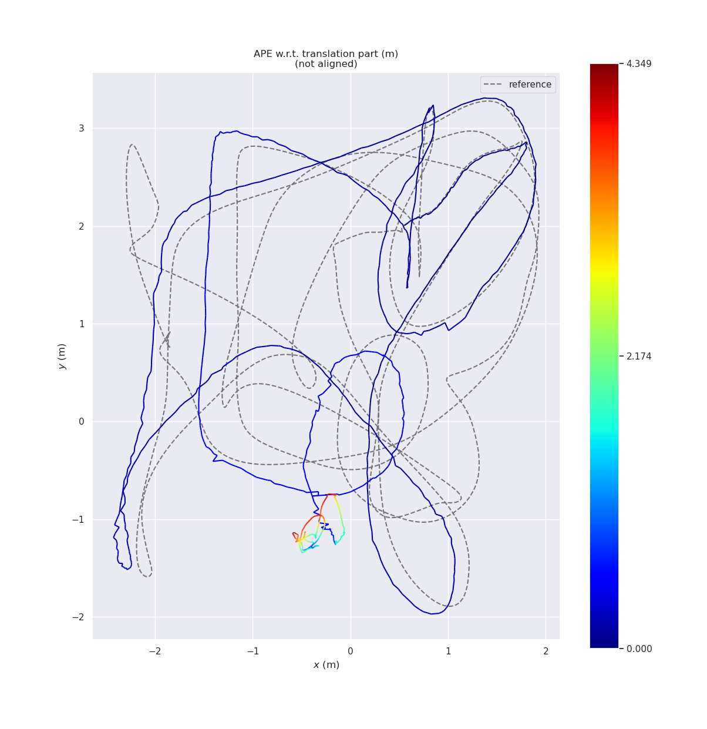
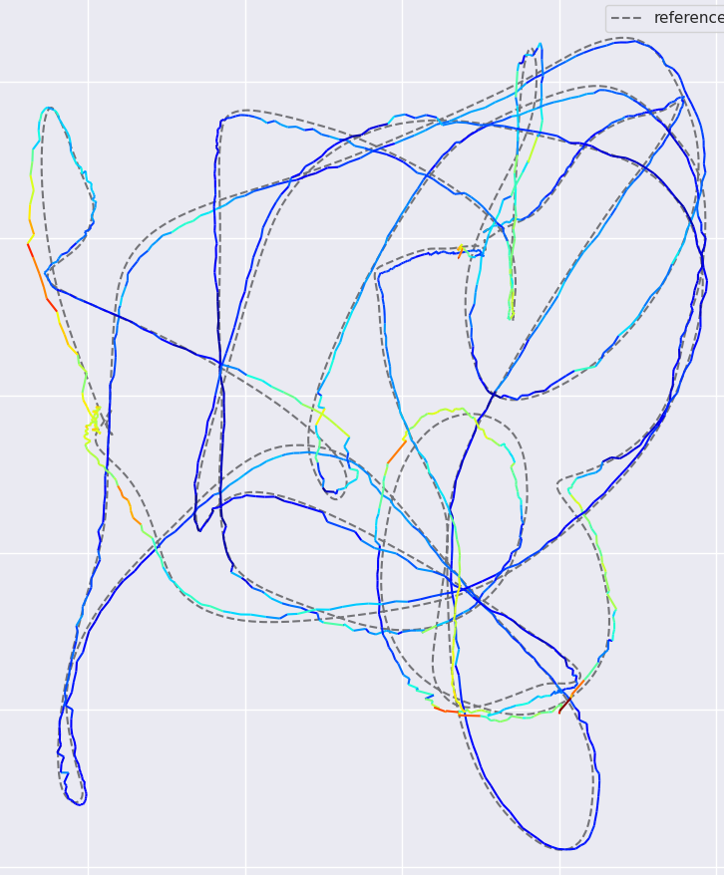
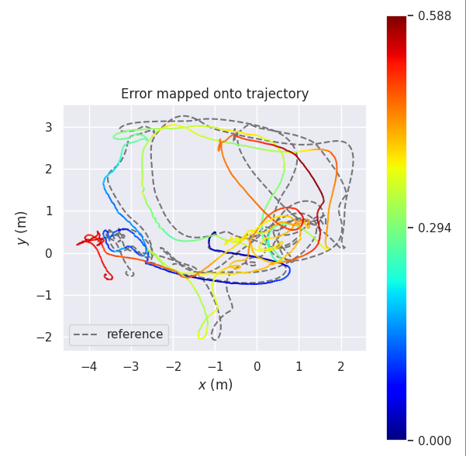
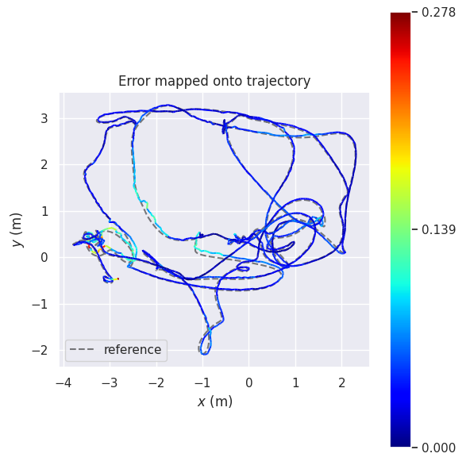
Other good results
V1_02_medium
V2_02_medium
Stereo
Stereo + LiDAR map
Monocular
Monocular + LiDAR map

Slide 18
Result

Slide 19
Ablation Study-Frequency of alignment
More alignments leads to better performance
Also leads to more running time!

Slide 20
Ablation Study-Voxel Size
Voxel size is highly scene-specific
Trade-off between voxel size and running time

Slide 21
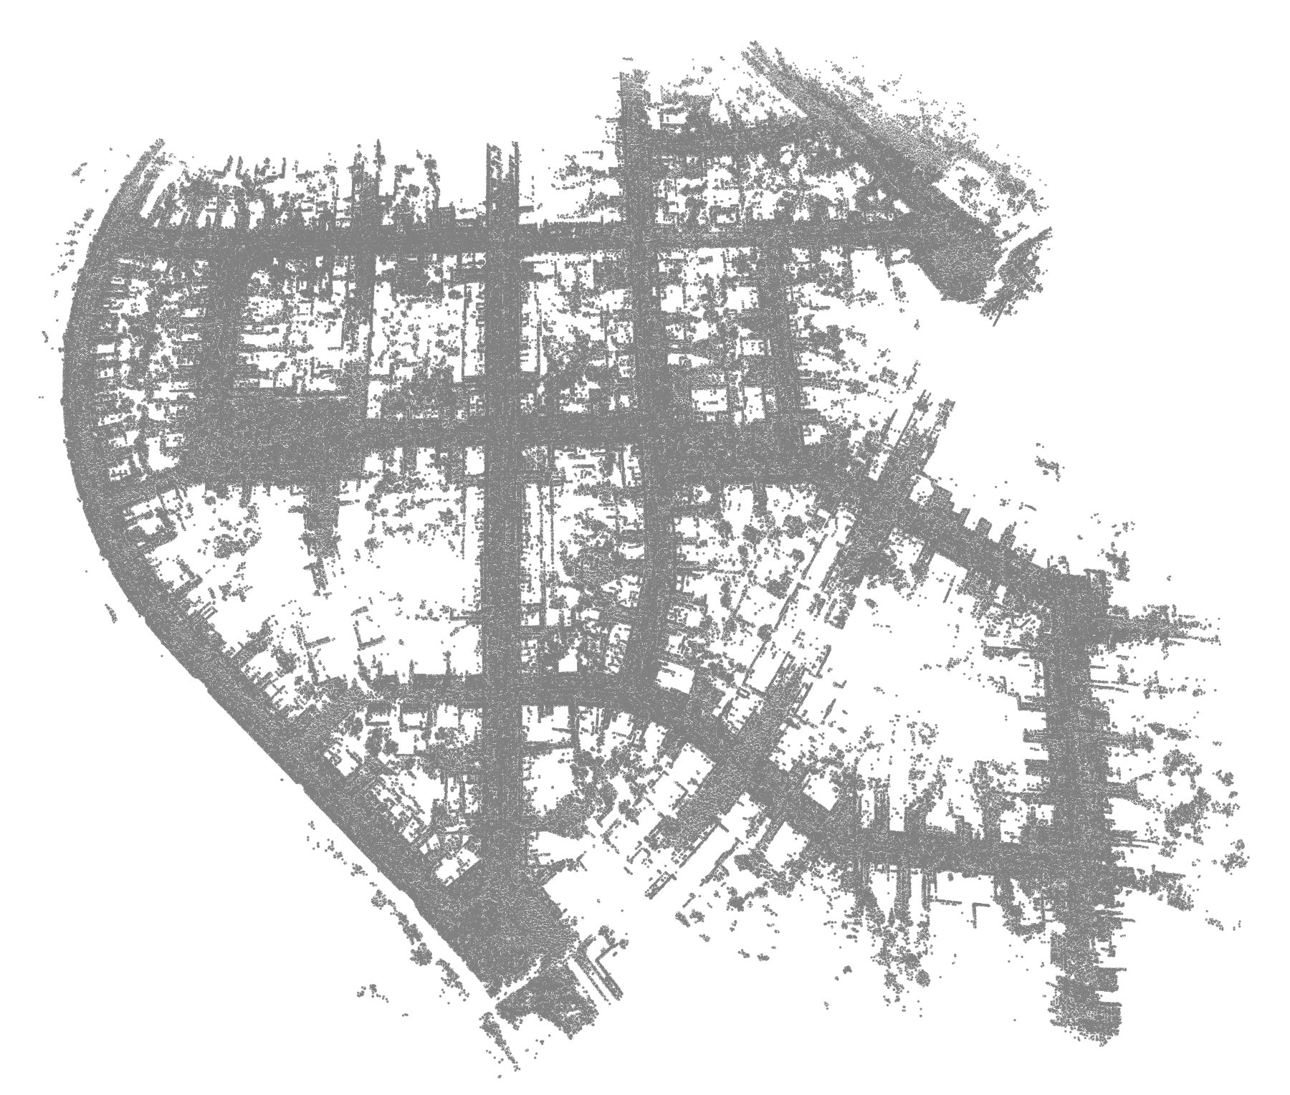
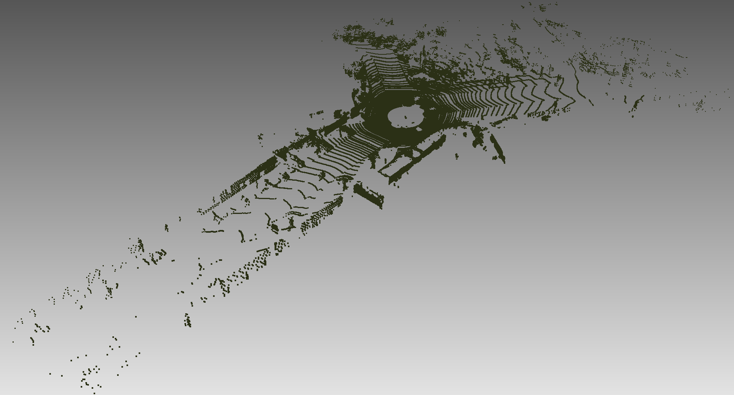
KITTI Attempt
Euroc: LiDAR map of the whole scene (~100 Mb/scene)
KITTI: Each frame has a LiDAR map (.bin file) (~10 Gb/scene)
Using downsample to preprocess a map for whole scene
data.ply for one Euroc Scene
000000.bin in KITTI Sequence (~130k points)
Our LiDAR Map for whole scene

Slide 22
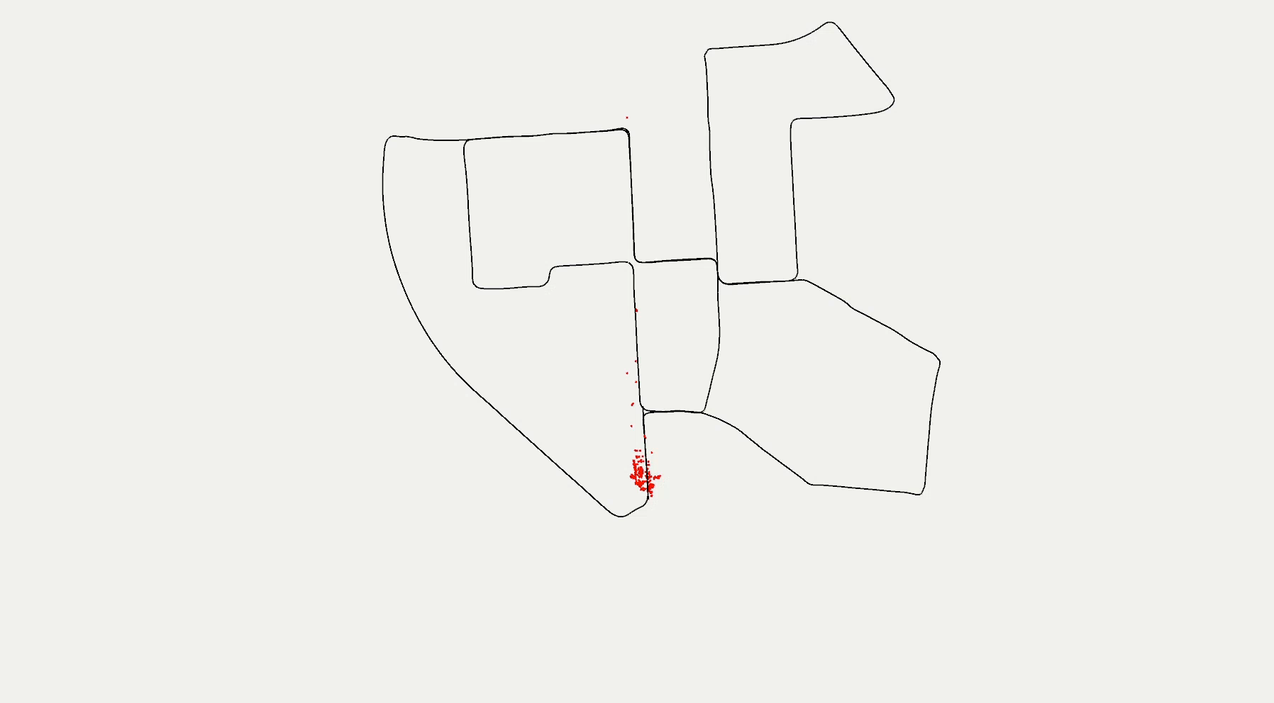
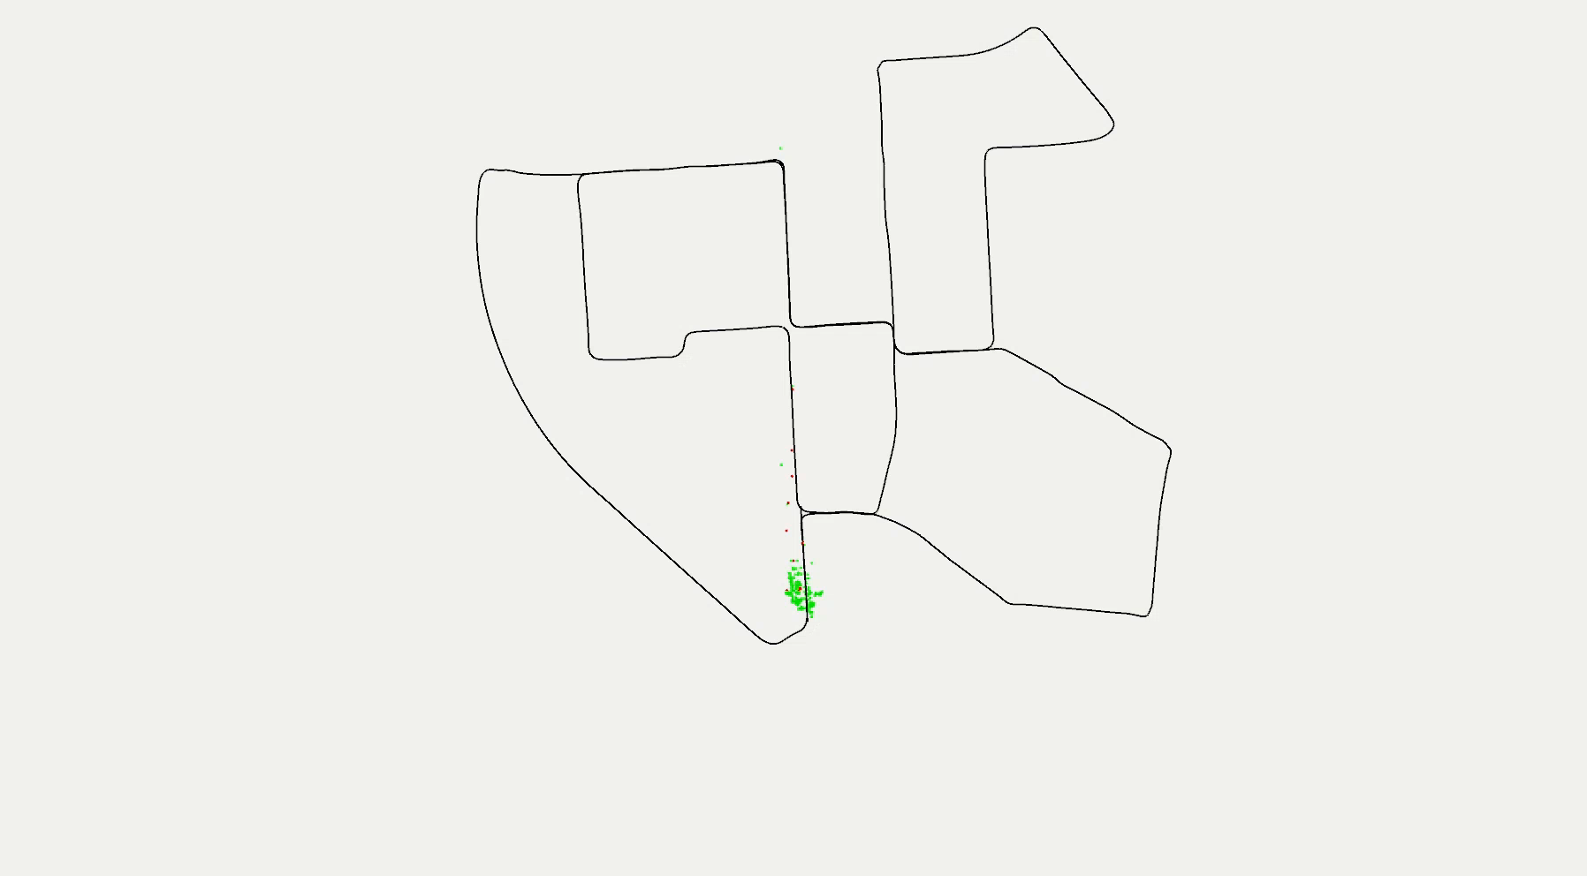
KITTI Attempt-Result
Stereo
Stereo + whole LiDAR map

Slide 23
Summary
Contribution
Alignment with LiDAR map can eliminate the accumulated drift
Matching based on geometry is robust to light changes
The alignment performance is still restricted by the based VO performance
Improvement potential
Powerful CPU
Accurate LiDAR Map
Powerful based VO

Slide 24
Thanks for your attention!

Slide 25
Additional Materials

Slide 26
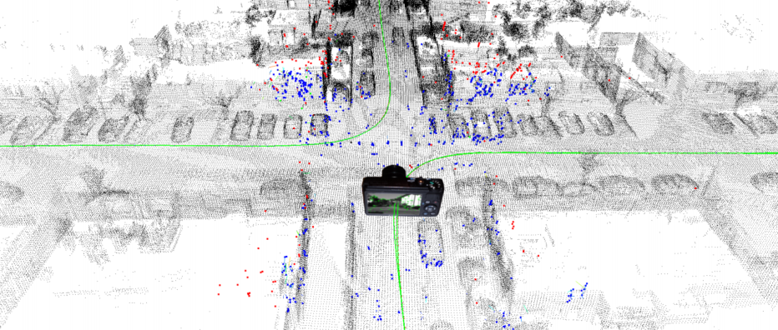
KITTI-Attempt
Paper’s method
Use a LIDAR-based SLAM system to get GT trajectory (for loop closure)
Build a map at resolution of 20 cm
Our method
Preprocess a LiDAR map for whole scene
Put point clouds for all frames together
Downsample
Build a map at resolution of 50cm
Paper’s LiDAR Map for whole scene
Our LiDAR Map for whole scene

